Slide 1
Top-down verses bottom-up approach

Slide 2
What is Top-Down Approach?
Top-Down Approach is an approach to design software in which a bigger problem is broken down into smaller parts. Thus, it uses the decomposition approach. This approach is generally used by structured programming languages such as C, COBOL, FORTRAN.
The drawback of using the top-down approach is that it may have redundancy since every part of the code is developed separately.
Also, there is less interaction and communication between the modules in this approach.

Slide 3
Advantages
Breaking problems into parts help us to identify what needs to be done.
At each step of refinement, new parts will become less complex and therefore easier to solve.
Parts of the solution may turn out to be reusable.
Breaking problems into parts allows more than one person to solve the problem.

Slide 4
Bottom-Up Approach
Bottom-Up Approach is one in which the smaller problems are solved, and then these solved problems are integrated to find the solution to a bigger problem. Therefore, it uses composition approach.
It requires a significant amount of communication among different modules. It is generally used with object oriented programming paradigm such as C++, Java, and Python. Data encapsulation and data hiding is also implemented in this approach. The bottom-up approach is generally used in testing modules.

Slide 5
Advantage
Make decisions about reusable low-level utilities then decide how there will be put together to create high-level construct. ,
The contrast between Top-down design and bottom-up design.

Slide 6
Difference between Top-Down Approach and Bottom-Up Approach
 | Top-Down Approach | Bottom-Up Approach
 | In this approach, the problem is broken down into smaller parts. | In this approach, the smaller problems are solved.
 | It is generally used by structured programming languages such as C, COBOL, FORTRAN, etc. | It is generally used with object oriented programming paradigm such as C++, Java, Python, etc.
 | It is generally used with documentation of module and debugging code. | It is generally used in testing modules.
 | It does not require communication between modules. | It requires relatively more communication between modules.
 | It contains redundant information. | It does not contain redundant information.
 | Decomposition approach is used here. | Composition approach is used here.
 | The implementation depends on the programming language and platform. | Data encapsulation and data hiding is implemented in this approach.

Slide 7
The most significant difference between the two is that the top-down approach is mainly used in structure programing languages like C, COBOL, etc., while the bottom-up approach is used in object oriented programming languages like C++, Java, Python, etc.

Slide 8
 | Pros- Easier isolation of interface errors It benefits in the case error occurs towards the top of the program. Defects in design get detected early and can be corrected as an early working module of the program is available. | Pros- Easy to create test conditions Test results are easy to observe It is suited if defects occur at the bottom of the program.
 | Cons- Difficulty in observing the output of test case. Stub writing is quite crucial as it leads to setting of output parameters. When stubs are located far from the top level module, choosing test cases and designing stubs become more challenging. | Cons- There is no representation of the working model once several modules have been constructed. There is no existence of the program as an entity without the addition of the last module. From a partially integrated system, test engineers cannot observe system-level functions. It can be possible only with the installation of the top-level test driver.

Slide 9
Structured Programming
can be defined as a programming approach in which the program is made as a single structure. It means that the code will execute the instruction by instruction one after the other. It doesn’t support the possibility of jumping from one instruction to some other with the help of any statement like GOTO, etc. Therefore, the instructions in this approach will be executed in a serial and structured manner.

Slide 10
The languages that support Structured programming approach are:
C
C++
Java
C#
..etc
Assembly languages like Microprocessor 8085, etc, the statements do not get executed in a structured manner. It allows jump statements like GOTO. So the program flow might be random.

Slide 11
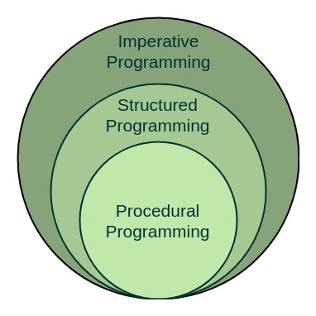

Slide 12
The structured program mainly consists of three types of elements:
Selection Statements
Sequence Statements
Iteration Statements
The structured program consists of well structured and separated modules. But the entry and exit in a Structured program is a single-time event. It means that the program uses single-entry and single-exit elements.

Slide 13
Advantages of Structured Programming Approach:
Easier to read and understand
User Friendly
Easier to Maintain
Mainly problem based instead of being machine based
Development is easier as it requires less effort and time
Easier to Debug
Machine-Independent, mostly.

Slide 14
Disadvantages of Structured Programming Approach:
Since it is Machine-Independent, So it takes time to convert into machine code.
The converted machine code is not the same as for assembly language.
The program depends upon changeable factors like data-types. Therefore it needs to be updated with the need on the go.
Usually the development in this approach takes longer time as it is language-dependent. Whereas in the case of assembly language, the development takes lesser time as it is fixed for the machine.

Slide 15
Modular Programming
Modular programming is the process of subdividing a computer program into separate sub-programs. A module is a separate software component. It can often be used in a variety of applications and functions with other components of the system.
Some programs might have thousands or millions of lines and to manage such programs it becomes quite difficult as there might be too many of syntax errors or logical errors present in the program, so to manage such type of programs concept of modular programming approached.

Slide 16
Each sub-module contains something necessary to execute only one aspect of the desired functionality.
Modular programming emphasis on breaking of large programs into small problems to increase the maintainability, readability of the code and to make the program handy to make any changes in future or to correct the errors.

Slide 17
Points which should be taken care of prior to modular program development:
Limitations of each and every module should be decided.
In which way a program is to be partitioned into different modules.
Communication among different modules of the code for proper execution of the entire program.

Slide 18
Advantages of Using Modular Programming Approach –
Ease of Use :This approach allows simplicity, as rather than focusing on the entire thousands and millions of lines code in one go we can access it in the form of modules. This allows ease in debugging the code and prone to less error.
Reusability :It allows the user to reuse the functionality with a different interface without typing the whole program again.
Ease of Maintenance : It helps in less collision at the time of working on modules, helping a team to work with proper collaboration while working on a large application.

Slide 19
C is called a structured programming language because to solve a large problem, C programming language divides the problem into smaller modules called functions or procedures each of which handles a particular responsibility. The program which solves the entire problem is a collection of such functions.
Module is basically a set of interrelated files that share their implementation details but hide it from the outside world. How can we implement modular programming in c? Each function defined in C by default is globally accessible.

Slide 20
Object Oriented Approach
In the object-oriented design method, the system is viewed as a collection of objects (i.e., entities). The state is distributed among the objects, and each object handles its state data.
In the approach, the focus is on capturing the structure and behavior of information systems into small modules that combines both data and process. The main aim of Object Oriented Design (OOD) is to improve the quality and productivity of system analysis and design by making it more usable.

Slide 21
The different terms related to object design are:
Objects: All entities involved in the solution design are known as objects. For example, person, banks, company, and users are considered as objects. Every entity has some attributes associated with it and has some methods to perform on the attributes.
Classes: A class is a generalized description of an object. An object is an instance of a class. A class defines all the attributes, which an object can have and methods, which represents the functionality of the object.
Messages: Objects communicate by message passing. Messages consist of the integrity of the target object, the name of the requested operation, and any other action needed to perform the function. Messages are often implemented as procedure or function calls.
Abstraction In object-oriented design, complexity is handled using abstraction. Abstraction is the removal of the irrelevant and the amplification of the essentials.

Slide 22
Encapsulation: Encapsulation is also called an information hiding concept. The data and operations are linked to a single unit. Encapsulation not only bundles essential information of an object together but also restricts access to the data and methods from the outside world.
Inheritance: OOD allows similar classes to stack up in a hierarchical manner where the lower or sub-classes can import, implement, and re-use allowed variables and functions from their immediate superclasses.This property of OOD is called an inheritance. This makes it easier to define a specific class and to create generalized classes from specific ones.
Polymorphism: OOD languages provide a mechanism where methods performing similar tasks but vary in arguments, can be assigned the same name. This is known as polymorphism, which allows a single interface is performing functions for different types. Depending upon how the service is invoked, the respective portion of the code gets executed.

Slide 23
Difference Between Structured and Object-oriented analysis :
Structured Analysis
The main focus is on the process and procedures of the system.
It uses (SDLC) methodology for different purposes like planning, analyzing, designing, implementing, and supporting an information system.
It is suitable for well-defined projects with stable user requirements.
Risk while using this analysis technique is high and reusability is also low.
Object-Oriented Analysis
The main focus is on data structure and real-world objects that are important.
It uses Incremental or Iterative methodology to refine and extend our design.
It is suitable for large projects with changing user requirements.
Risk while using this analysis technique is low and reusability is also high.

Slide 24
Structuring requirements include DFDs (Data Flow Diagram), Structured Analysis, ER (Entity Relationship) diagram, CFD (Control Flow Diagram), Data Dictionary, Decision table/tree, and the State transition diagram.
This technique is old and is not preferred usually.
Requirement engineering includes the Use case model (find Use cases, Flow of events, Activity Diagram), the Object model (find Classes and class relations, Object interaction, Object to ER mapping), Statechart Diagram, and deployment diagram.
This technique is new and is mostly preferred.

Slide 25
Advantages of Object-Oriented Analysis (OOA):
Reuse of Previous work: This is the benefit cited most commonly in literature, particularly in business periodicals. OOD produces software modules that can be plugged into one another, which allows creation of new programs. However, such reuse does not come easily. It takes planning and investment.
Scalability: OOA is more scalable than Structured Analysis, making it better suited for large, complex systems.
Object orientation: OOA provides the benefits of object orientation, including encapsulation, inheritance, and polymorphism, making it easier to manage and maintain large systems over time.
Better modeling of complex relationships: OOA enables better modeling of complex relationships between objects, making it better suited for modeling large, complex systems.
Faster Development: OOD has long been touted as leading to faster development. Many of the claims of potentially reduced development time are correct in principle, if a bit overstated.

Slide 26
Increased Quality: Increases in quality are largely a by-product of this program reuse. If 90% of a new application consists of proven, existing components, then only the remaining 10% of the code has to be tested from scratch. That observation implies an order-of-magnitude reduction in defects.
Modular Architecture: Object-oriented systems have a natural structure for modular design: objects, subsystems, framework, and so on. Thus, OOD systems are easier to modify. OOD systems can be altered in fundamental ways without ever breaking up since changes are neatly encapsulated. However, nothing in OOD guarantees or requires that the code produced will be modular. The same level of care in design and implementation is required to produce a modular structure in OOD, as it is for any form of software development.
Client/Server Applications: By their very nature, client/server applications involve transmission of messages back and forth over a network, and the object-message paradigm of OOD meshes well with the physical and conceptual architecture of client/server applications.
Better Mapping to the Problem Domain: This is a clear winner for OOD, particularly when the project maps to the real world. Whether objects represent customers, machinery, banks, sensors or pieces of paper, they can provide a clean, self-contained implication which fits naturally into human thought processes.

Slide 27
Disadvantages of Object-Oriented Analysis (OOA):
Steep learning curve: OOA can be more difficult to understand and implement than Structured Analysis, especially for those who are not familiar with object-oriented programming.
Bottom-up approach: The bottom-up approach of OOA can make it difficult to understand the high-level functions and processes involved in a software system, and to break them down into smaller, more manageable components.
Emphasis on objects: OOA places a strong emphasis on objects, making it more difficult to understand the relationships between data and processes.

Slide 28
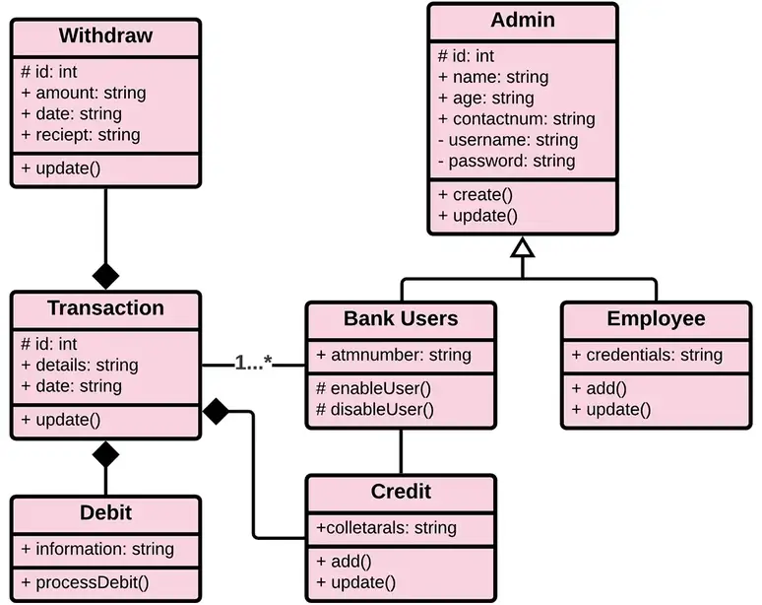
Bank Management System Class Diagram

Slide 29
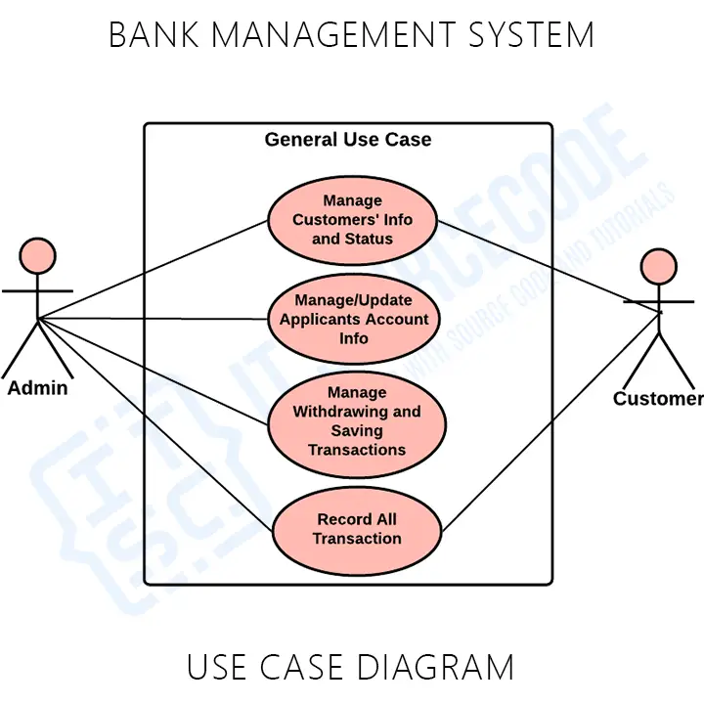
Bank Management System Use Case Diagram

Slide 30
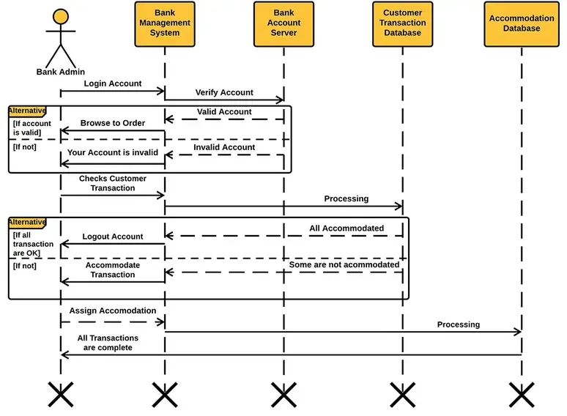
Bank Management System Sequence Diagram

Slide 31
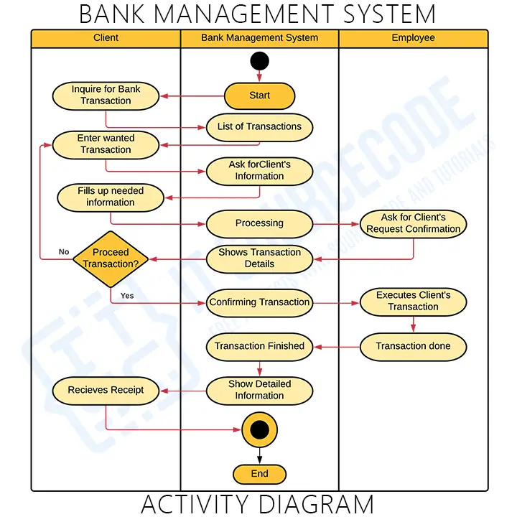
Bank Management System Activity Diagram

Slide 32
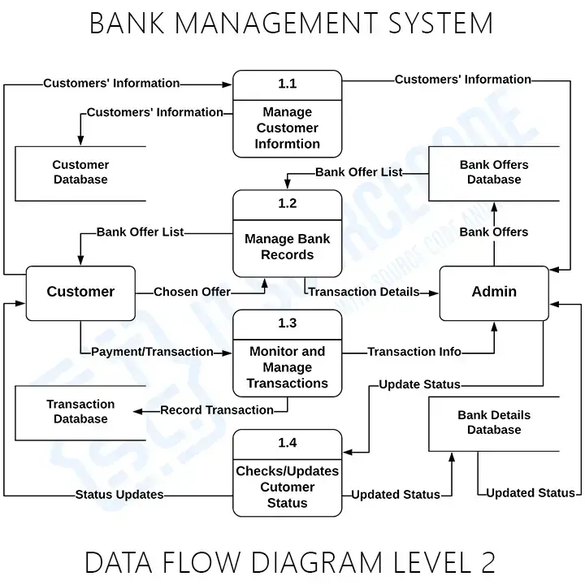
Data Flow Diagram

